Slide 1

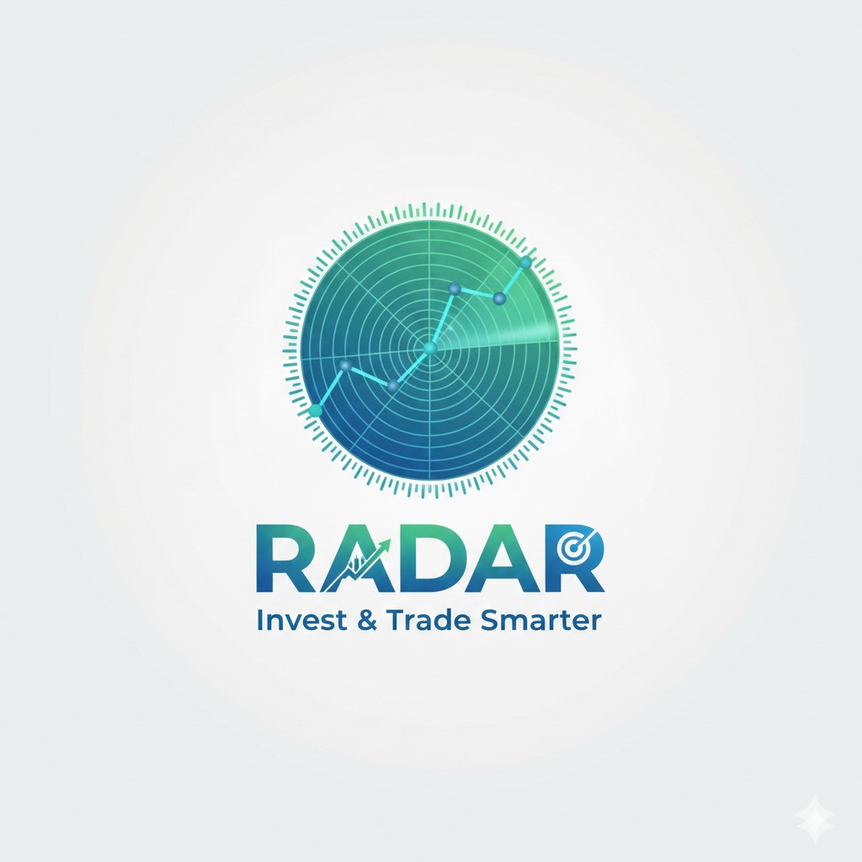


User Roles: Tailored Experiences
Investor Mode: Simplified for Long-Term Growth
Trader Mode: Advanced for Active Trading
Focused on portfolio performance and long-term trends.
Access to advanced charting tools and real-time market data.
Simplified interface with key metrics and growth projections.
Detailed technical indicators, and depth charts.
Ideal for users who prefer a less cluttered, strategic overview.
Designed for experienced users requiring granular control and analysis.
Notes:
6

Slide 2
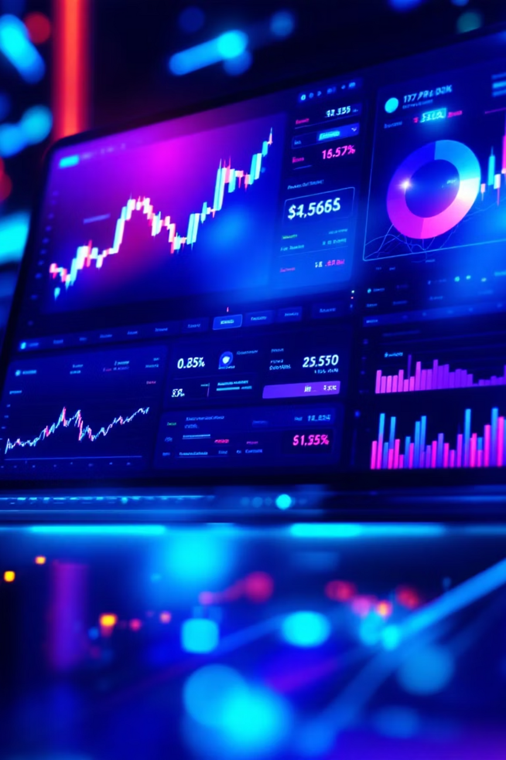
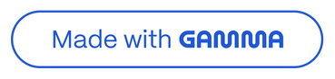
RADAR: Revolutionizing Financial Analytics
Welcome to RADAR, the next-generation web platform designed to empower both novice and seasoned investors and traders with cutting-edge financial analytics.
Notes:
1

Slide 3

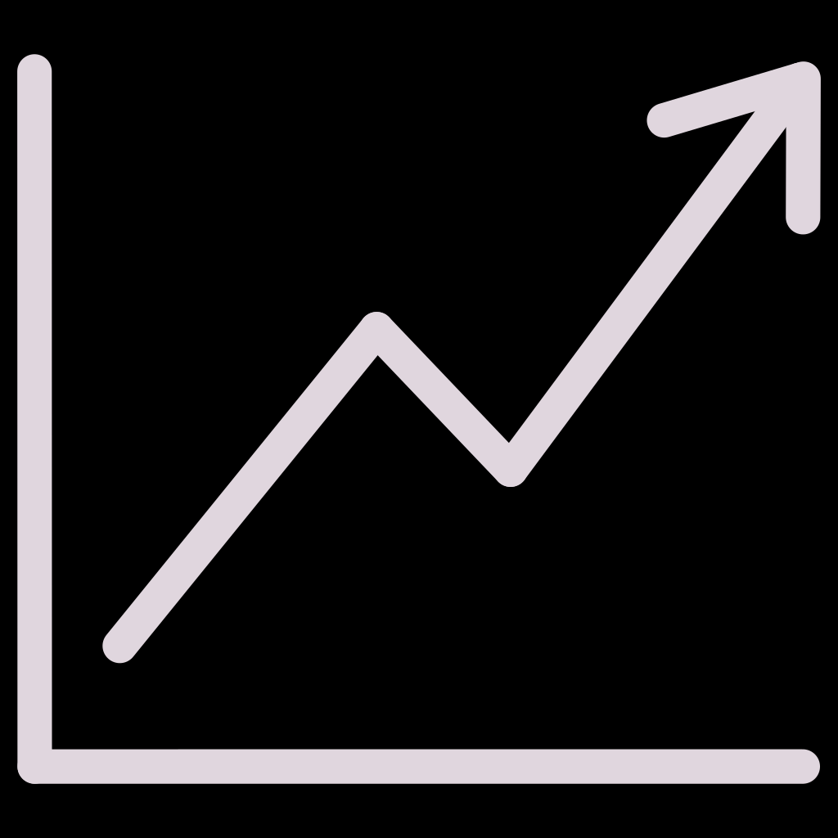
Project Overview: Unveiling RADAR
Visionary Platform
Empowering Users
A modern web platform dedicated to comprehensive financial analytics.
Providing powerful tools for investors and traders of all experience levels.
Unified Experience
Bridging the gap between simplified investing and advanced trading needs.
Notes:
2

Slide 4

The Challenge: Fragmented Financial Tools
Fragmented Financial Ecosystem
Users depend on multiple platforms to access tools and real-time data across stocks, crypto, and forex, resulting in workflow friction, context switching, and reduced decision clarity.
Lack of Adaptive User Experience :
Existing platforms fail to balance simplicity and power — beginners are overwhelmed by complex interfaces, while experienced traders lack a unified, multi-asset environment tailored to advanced workflows.
Notes:
3

Slide 5
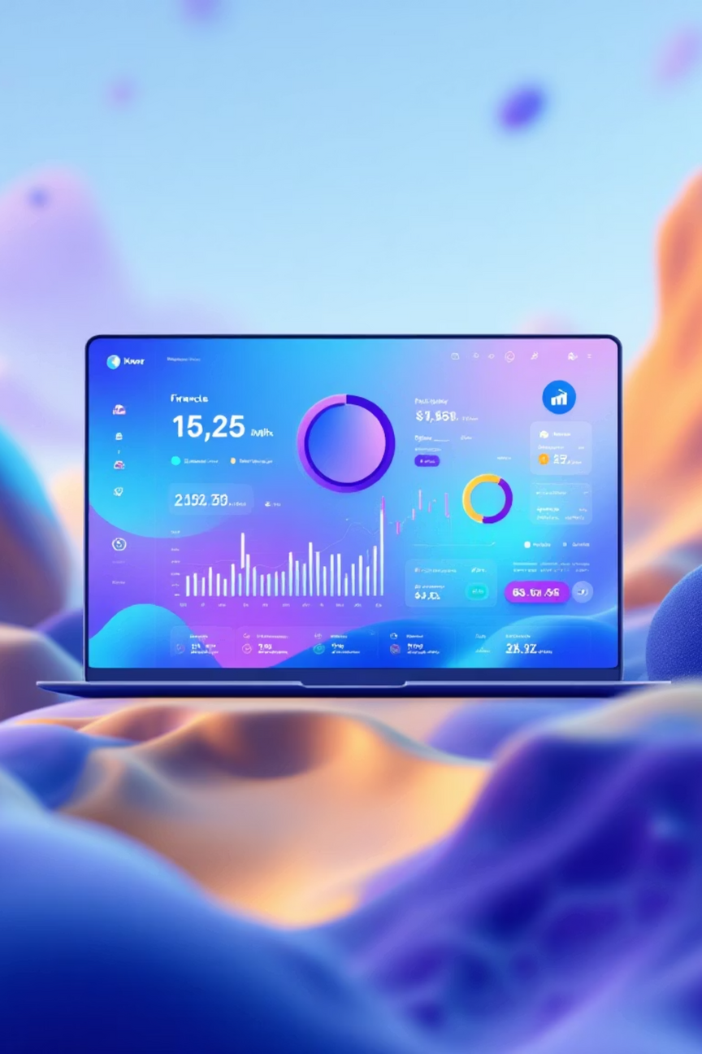
RADAR's Solution: One Platform, Endless Possibilities
Integrated Analytics
Intuitive Design
A single, powerful platform for all your investment and trading activities.
Clean, user-friendly interface tailored to different user personas.
Cross-Asset Support
Seamlessly manage stocks, cryptocurrency, and forex in one place.
Notes:
4

Slide 6


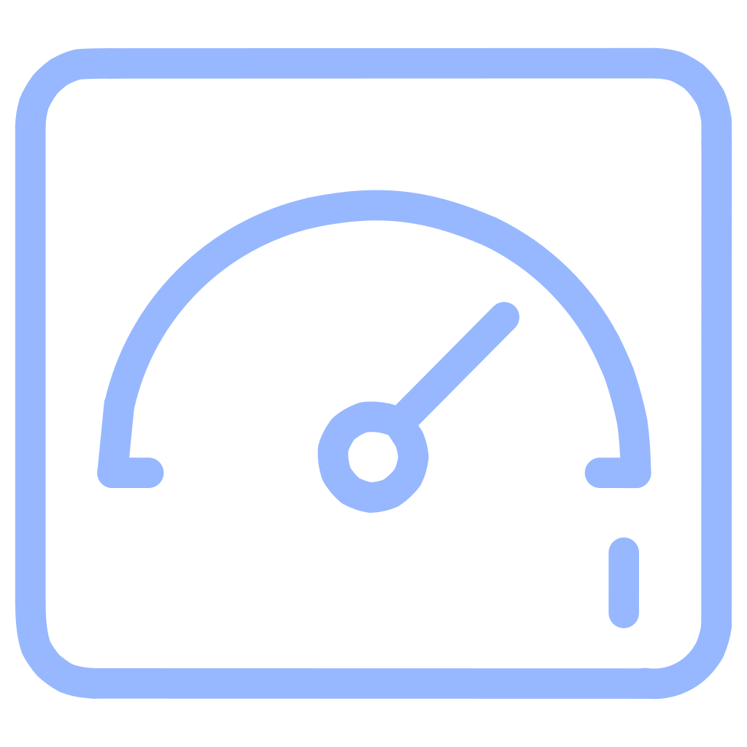

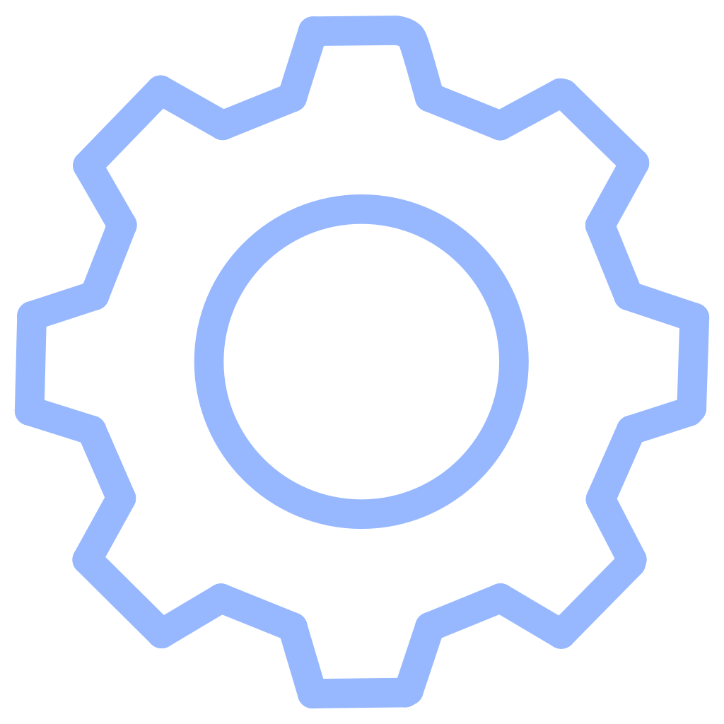
Key Features: Empowering Your Financial Journey
Secure Access
Robust login and registration ensure your data is always protected.
Clean Dashboard
A personalized overview designed for clarity and immediate insights.
Strong Identity
A consistent and recognizable brand experience across the platform.
Customizable
Tailor your view and tools to match your unique financial strategy.
Notes:
5

Slide 7




Dynamic Switching: Seamless Transition
Investor Mode
Toggle
Trader Mode
Simplified view, long-term focus, portfolio health.
Effortlessly switch between modes with a single click.
Advanced charts, real-time data, technical analysis.
Notes:
7

Slide 8
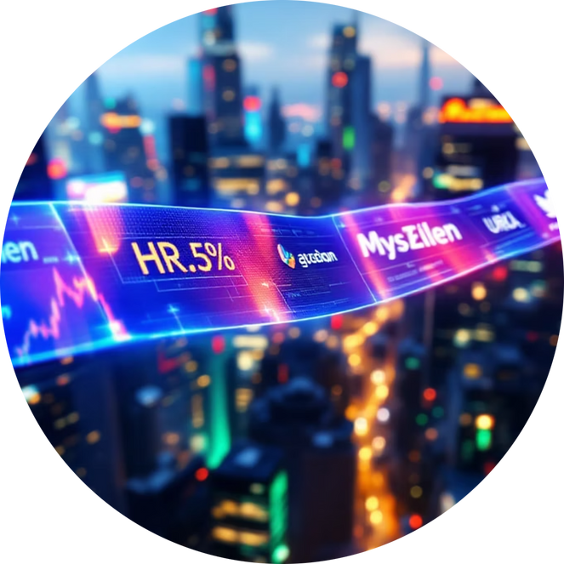

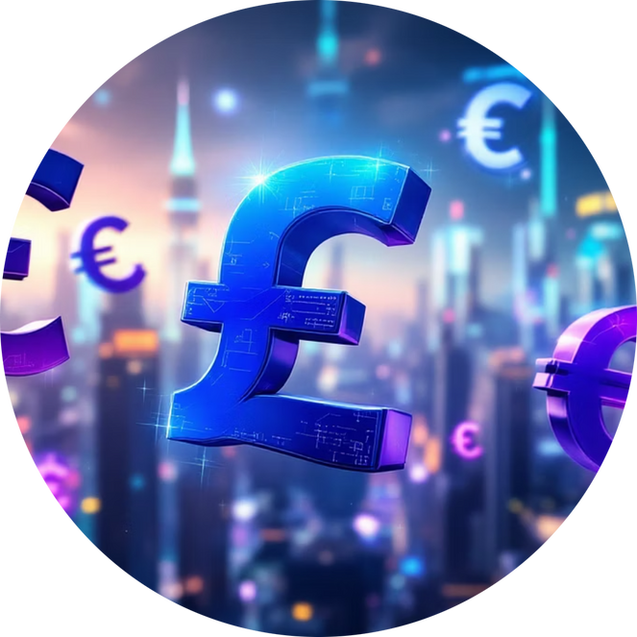
Comprehensive Asset Coverage
Stocks
Cryptocurrency
Forex
Real-time data and analytics for global equity markets.
Track, analyze, and manage your digital asset portfolio.
In-depth insights into the dynamic foreign exchange market.
RADAR provides a unified view across all major asset classes, eliminating the need for multiple platforms.
Notes:
9

Slide 9

RADAR: Bridging the Gap
RADAR is more than just an analytics platform; it's a bridge. It connects the world of beginners, seeking simplified, long-term investment insights, with the advanced functionalities demanded by seasoned traders.
One Unified Interface for All Your Financial Ambitions.
Notes:
10

Slide 10
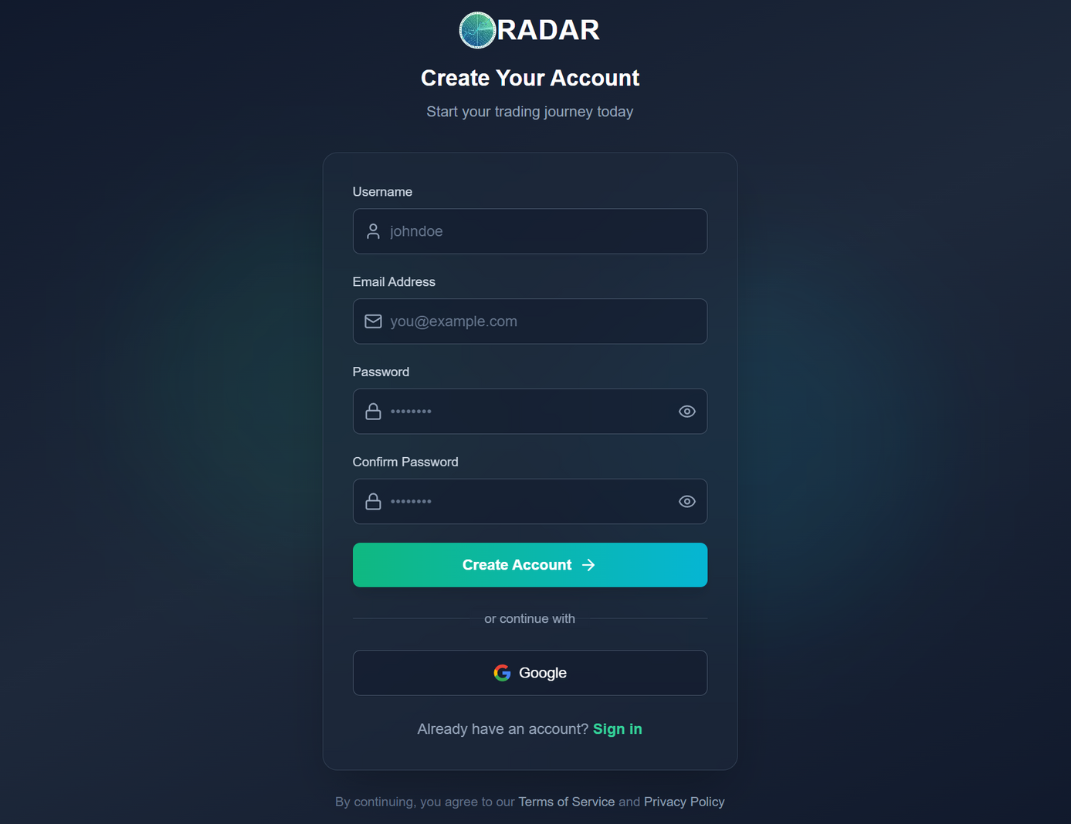

Slide 11
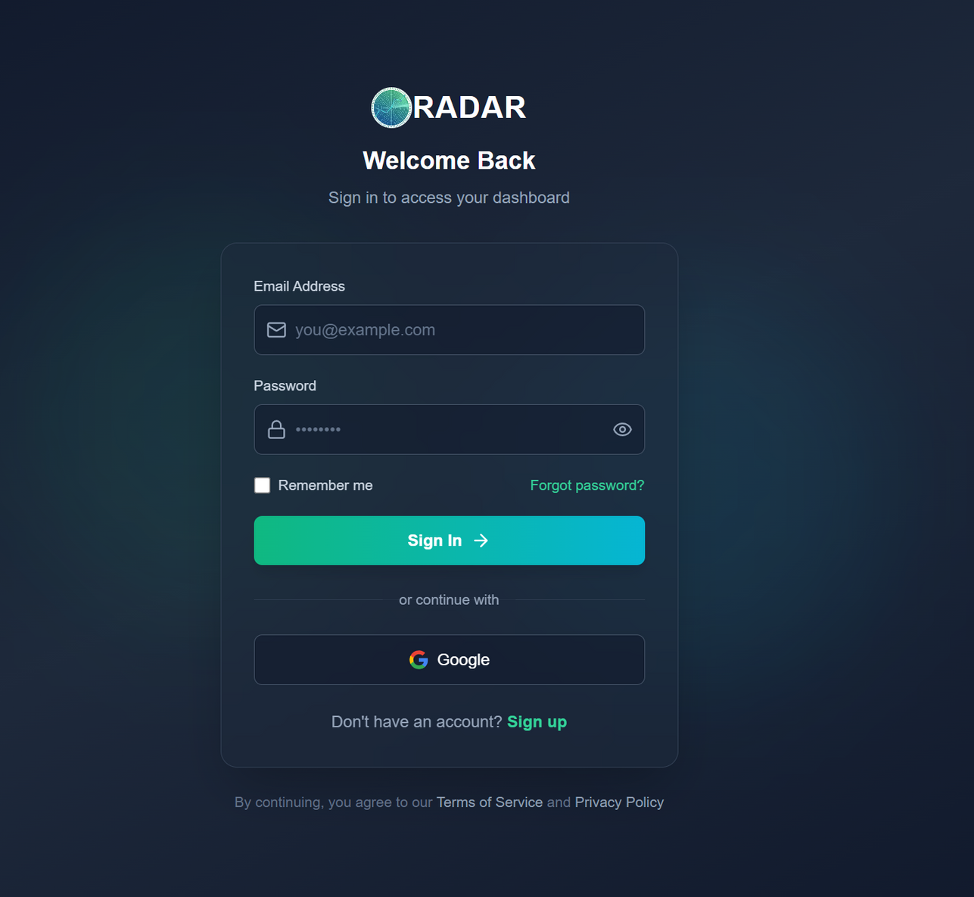

Slide 12
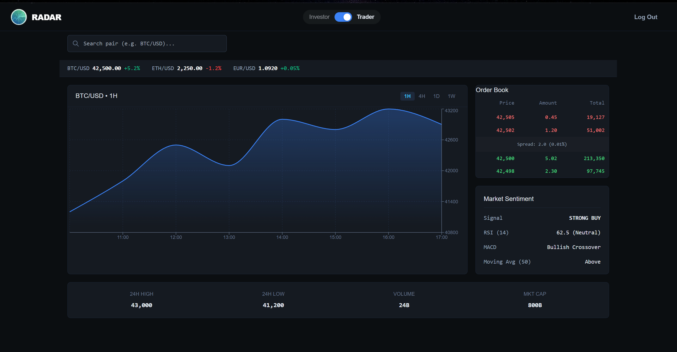

Slide 13
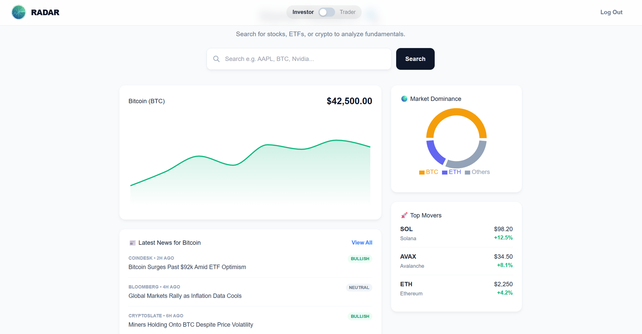

Slide 14
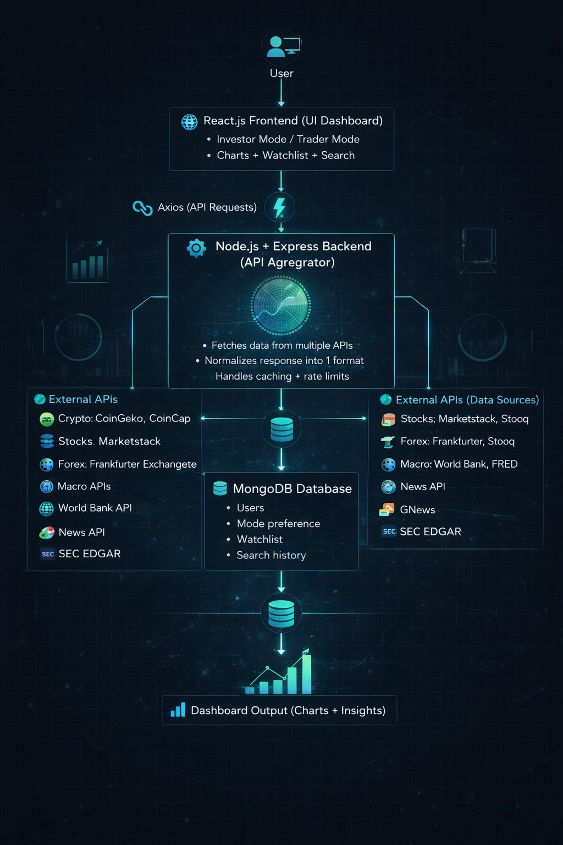

Slide 15
Thank You
Notes:
10

